Slide 1


RESUMA
AI-Powered Resume Optimization using Multi-Agent Architecture
By Rasha Hammoud & Faten Mortada
Supervisor: Dr. Mohamad AOUDE
Lebanese University – Faculty of Engineering III

Slide 2

What Is an AI Agent?
An AI Agent is an intelligent program that perceives its environment and takes actions to achieve specific goals.
In this project, agents simulate roles like Resume Evaluator, Editor, Strategist, and Cover Letter Writer.
They use large language models (LLMs) like LLaMA 3 to perform reasoning, critique, and optimization.

Slide 3

Technologies Used
AI Models
2.
Backend
3.
Framework
1.
LLAMA 3 via local LLM interface
Python 3.10
FastAPI for API endpoints
Database
5.
Document Handling
6.
Agent System
4.
SQLite for storing submissions
LaTeX (resume output), JSON, PDF
Custom prompt-chaining logic for multiple agents

Slide 4

Project Overview
Goal: Automatically enhance a user’s resume to better match a job description using AI.
Input
Output
A PDF resume
+
a job description
System
Improved LaTeX resume (.tex and .json)
+
Customized cover letter (.txt)
+
Evaluation report (.json)
+
Course recommendations (.json)

Slide 5
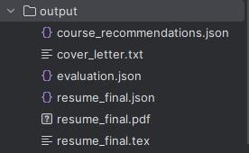
Final Output Files

Slide 6
Meet the Agents
Agent | Role | Output
Evaluator | Analyzes resume vs. job, gives feedback | Rating (1–10), JSON feedback
Strategist | Decides whether resume needs improvement | True/False decision
Editor | Improves resume based on evaluator feedback | New resume JSON
Cover Letter | Writes a personalized letter | Cover letter text

Slide 7

System Architecture
Resume Pdf
Parser
Evaluator Agent
Strategist Agent
Editor Agent
Cover Letter Agent
Resume Final JSON
LaTeX Builder

Slide 8
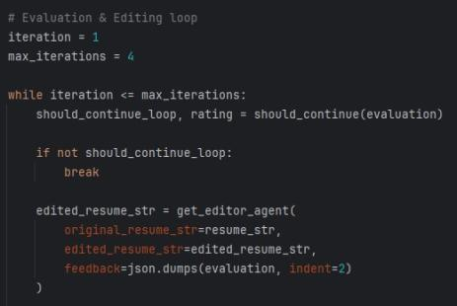
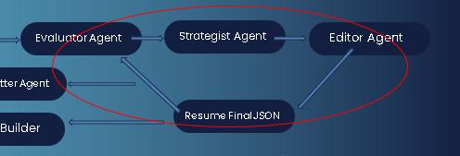
Iterative Intelligence Loop
Resume evaluated multiple times
If rating < target, loop continues
Stops when resume quality meets threshold

Slide 9
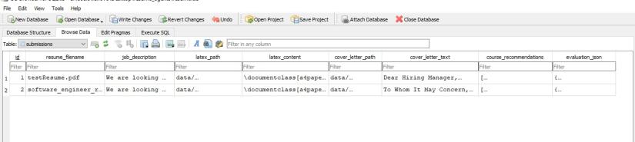
SQLite: Submission Tracking
Each Submission logged with:
Resume filename
Job description
Evaluation result
Course recommendations
Paths to generated files

Slide 10

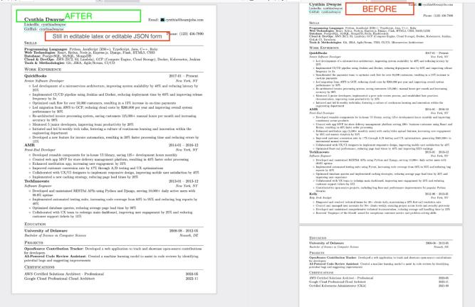

Before & After
RESUMA

Slide 11
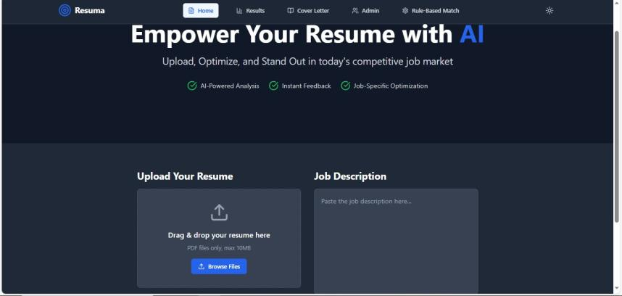
Frontend Overview

Slide 12
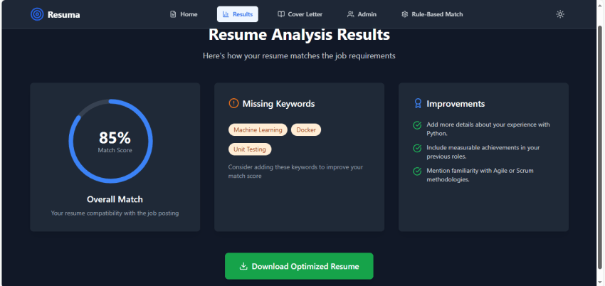
Frontend Overview

Slide 13
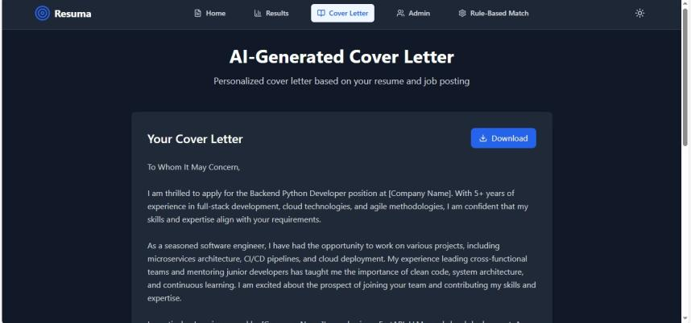
Frontend Overview

Slide 14
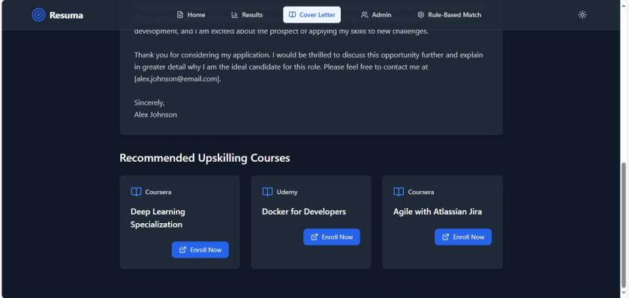
Frontend Overview

Slide 15
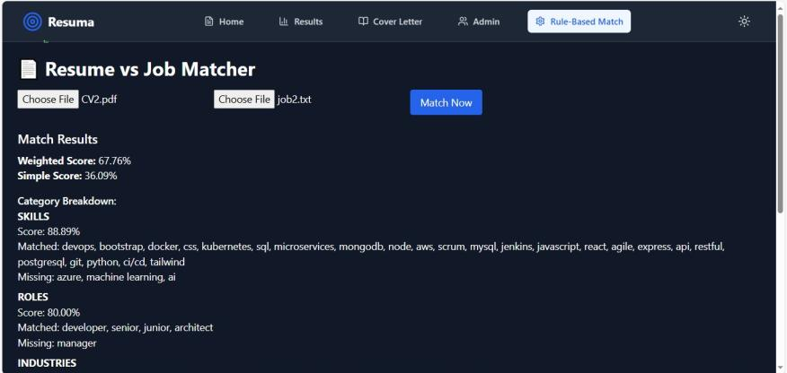
Rule-Based System

Slide 16
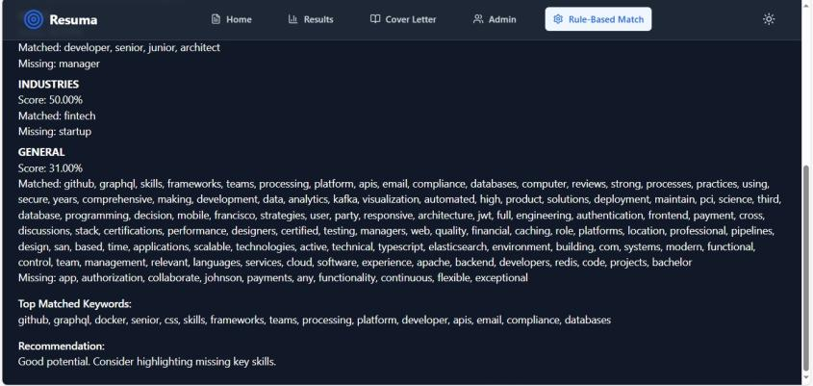
Rule-Based System

Slide 17



Key Strengths of the Multi-Agent System
Modular agent-based design
Offline + privacy focused
Iterative resume improvement
LaTeX rendering for professional output
Real-time FastAPI integration

Slide 18

Future Roadmap
1.
Linkedin and ATS Integration
2.
Multilingual Resume Support
3.
Dashboard for Recruiters
4.
Secure Cloud Deployment

Slide 19

Thank You
FOR YOUR ATTENTION

